Slide 1
Machine Learning basics

Slide 2
Traditional Programming
Given some problem, formulate it into a formal computational problem
Design an algorithm to solve the problem
Implement the algorithm using some programming language

Slide 3
Machine Learning
Machines learn from data
Machine Learning is a subfield of Artificial Intelligence that provides systems the ability to automatically learn how to do a specific task (training) from experience and examples (i.e., data) without the specific task being explicitly programmed.
Notes:
As human learning from past experience, computers learn from data.
The idea of ML is to program the computer to learn the rules of a specific task from the provided data instead of explicitly program the specific task as in traditional programming.

Slide 4

Machine Learning
It is a method of data analysis that builds analytical model from data automatically.
It is a branch of artificial intelligence based on the idea that systems can learn from data, identify patterns and make decisions with minimal human intervention.
Model Building algorithm
Model
Data
Output y
Input x

Slide 5
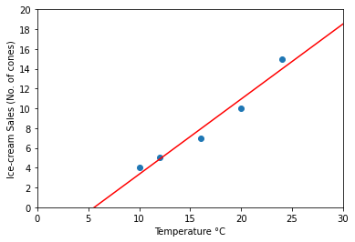
Example
Model Building algorithm
Model
Data
Output y
Input x
X0, f(X0)
X1, f(X1)
…
Xn, f(Xn)
Linear Regression Model Building algorithm
y = 2x + 10
Output
30
(=2x10m+10)
Input 10

Slide 6
Traditional Programming vs Machine Learning
Traditional Programming
Machine Learning
There are a huge number of problems need to be solved, and different problems need different programs, no matter how similar the problems are.
Thus, we need a lot of programmers, and there are top programmers, average programmers, and poor programmers.
The programs written by top programmers are much better than those written by average programmers.
A user who has the best programs (software tools) has better chance to outperform his/her competitors.
Similarly, there are a huge number of data sets for which we need to build models for them.
But, there are a much smaller number of model building algorithms (e.g., Kmean, Linear regression, Neural network)
Most of these model building algorithms have been implemented by the best programmers in the world, and their programs can be assessed easily via internet.
A user who has the best data has better change to outperform his/her competitors.
Notes:
Let’s take a look at the difference between traditional programming and ML.
In traditional programming, we program all the rules to do a task. E.g. let’s say we have a task to classify apples and pears, we may have some rules like if input is red, then the answer is apple. If input is yellow, then the answer is pear. But the problem is, there are too many rules that we cannot program all the rules, and for more complicated problems, e.g. to classify cats and dogs, we actually don’t even know about all those rules.
So, instead of programming all the rules explicitly, ML is to program the computer to learn those rules from the provided data.
Let say we have some training data of apples and pears, the ML algorithm will learn the rules from the training data to classify apples and pears, the learned rules is called a model, then we can use the model to classify a new data.
And such ML program can be reused, if we fit different data to the ML program, different sets of rules will be learned, producing different models for different tasks.

Slide 7
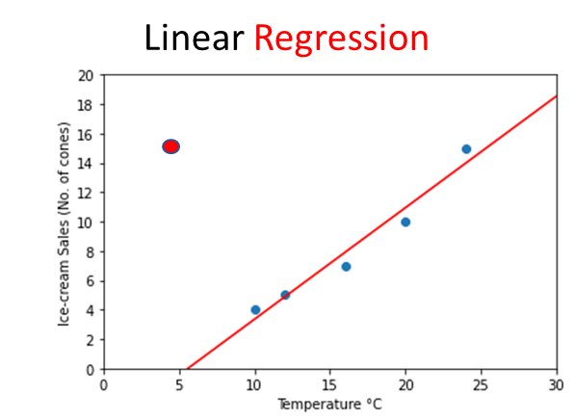
Traditional Programming vs Machine Learning
Traditional Programming
It requires absolute correctness, i.e., for any input, the program should return the correct output.
Machine Learning
It requires probably approximately correct.
Example
The model (i.e., the red line,) approximates most of the points well (i.e., the points are close to the line).
The model gives poor approximation for some points (the red one), but that is okay because red points are rare, and the probability that we “see” them is very small.
Notes:
Let’s take a look at the difference between traditional programming and ML.
In traditional programming, we program all the rules to do a task. E.g. let’s say we have a task to classify apples and pears, we may have some rules like if input is red, then the answer is apple. If input is yellow, then the answer is pear. But the problem is, there are too many rules that we cannot program all the rules, and for more complicated problems, e.g. to classify cats and dogs, we actually don’t even know about all those rules.
So, instead of programming all the rules explicitly, ML is to program the computer to learn those rules from the provided data.
Let say we have some training data of apples and pears, the ML algorithm will learn the rules from the training data to classify apples and pears, the learned rules is called a model, then we can use the model to classify a new data.
And such ML program can be reused, if we fit different data to the ML program, different sets of rules will be learned, producing different models for different tasks.

Slide 8
Different Types of Machine Learning
Unsupervised Learning |  | Supervised Learning |  | Reinforcement Learning
Clustering | Consumer segmentation | Classification | Fraud detection | - | Real-time decisions
 |  |  |  |  | Robot Navigation
 | Recommendation System |  | Image classification
 |  |  |  |  | Skill acquisition
Density Estimation | - | Regression | Price prediction
 |  |  | Weather forecast
 |  |  |  |  | Game AI
Notes:
There are different types of machine learning and different algorithms for different applications.

Slide 9
Supervised Learning
To learn a function that maps an input to an output based on examples of input + label (which is the correct output) pairs
The model is trained on a input + label dataset (build model that gives good prediction on the label for the inputs in the dataset).
Then, it can use this model to predict the outcome (i.e., the labels) of out-of-sample data.
Example on the input-label dataset
Item | Color | Shape | Label
1 |  | small round | Apple
2 |  | big oval | Pear
3 |  | small round | Apple
4 |  | big round | Apple
: | : | : | :
: | : | : | :
1000 |  | big triangle | Pear
Notes:
There’re different types of ML. categorized by the input and the output.
Supervised learning is like the kids learn from the flash cards that this is an apple, orange, banana and then when mom brings the kid to the supermarket, the kid is able to identify that this is an apple, that is an orange, etc. although those apples/oranges in the supermarket are not the same as the one on the flash cards. So the flash cards act as training data while those in the supermarket are out-of-sample data.
In Supervised learning, the input is a labelled dataset, e.g. 1000 items, with different colors and shapes, each labelled as apple/pear,
the ML program learns the function or the rules from the labelled dataset, e.g. what colors classify apples, what shapes classify pears, etc. and then use those the learned rules to predict the outcome of out-of-sample data.

Slide 10
Supervised learning: Regression
Regression refers to the general statistical method for determining the relationship between input x and output y, where x and y can be high-dimensional vectors.
Example: Find a linear relationship between x and y where x, y are just single real numbers.
Linear Regression
Temperature (°C) x | Ice-cream Sales (No. of cones) y
10 | 4
12 | 5
16 | 7
20 | 10
24 | 15
30 | ?
Notes:
Another type of supervised learning problem is like this, let’s say we have recorded the temperature and the ice-cream sales in the past few days, then given the weather forecast saying tomorrow’s temperature is going to be 30°C, we want to predict the ice-cream sales so that we will know how many cones to prepare.
This is an example of regression problem, temperature is the predictor and we want to predict the no. of cones which is a value.
Here, we plotted the temperature and ice-cream sales on a graph shown as the blue dots, regression is to find a line that best fit the data points, and then we from the line we can predict if tomorrow’s temperature is 30°C, 18 cones will be sold. In this example, the prediction follows a straight line, this is simple linear regression.
In some cases, a straight line may not fit, then this is a polynomial linear regression.
When there are multiple predictors, then that is a multiple linear regression.

Slide 11
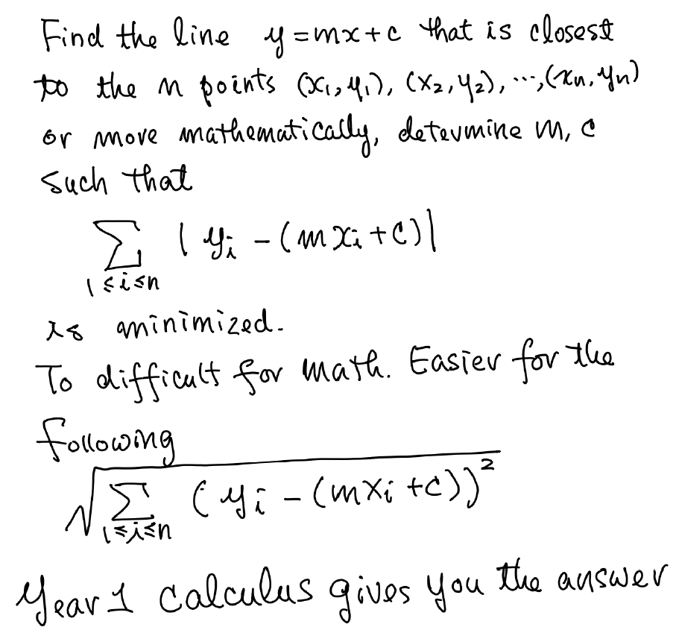

Slide 12
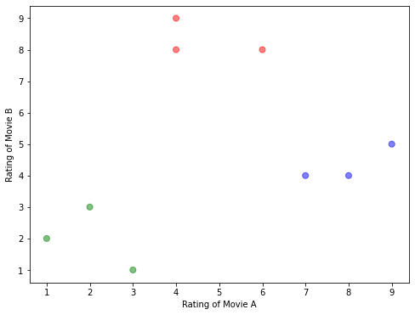
Unsupervised Learning: Clustering
To train and construct a model from which we can determine a natural grouping in data
User | Rating of Movie A | Rating of Movie B
1 | 1 | 2
2 | 7 | 4
3 | 2 | 3
4 | 6 | 8
5 | 4 | 8
6 | 8 | 4
7 | 9 | 5
8 | 3 | 1
9 | 4 | 9
Notes:
Let’s take a look at this problem.
Let’s say here we have the movie ratings from 10 users, would you recommend movie B to user 10? Will user 10 like movie B?
This is a clustering problem, we want the computer to discover the natural grouping in data, then we know user 10 shall belong to the red group which like movie B a lot.

Slide 13
Unsupervised Learning: Clustering
To train and construct a model from which we can determine a natural grouping (according to some “distance” metric) in data
User | Rating of Movie A | Rating of Movie B
1 | 1 | 2
2 | 7 | 4
3 | 2 | 3
4 | 6 | 8
5 | 4 | 8
6 | 8 | 4
7 | 9 | 5
8 | 3 | 1
9 | 4 | 9
Notes:
Let’s take a look at this problem.
Let’s say here we have the movie ratings from 10 users, would you recommend movie B to user 10? Will user 10 like movie B?
This is a clustering problem, we want the computer to discover the natural grouping in data, then we know user 10 shall belong to the red group which like movie B a lot.

Slide 14
Unsupervised Learning: Clustering
To train and construct a model from which we can determine a natural grouping (according to some “distance” metric) in data
User | Rating of Movie A | Rating of Movie B
1 | 1 | 2
2 | 7 | 4
3 | 2 | 3
4 | 6 | 8
5 | 4 | 8
6 | 8 | 4
7 | 9 | 5
8 | 3 | 1
9 | 4 | 9
If we have a distance definition, we can determine whether
two points are close, and then, we can group points close to
each other to form one cluster.
Notes:
Let’s take a look at this problem.
Let’s say here we have the movie ratings from 10 users, would you recommend movie B to user 10? Will user 10 like movie B?
This is a clustering problem, we want the computer to discover the natural grouping in data, then we know user 10 shall belong to the red group which like movie B a lot.

Slide 15
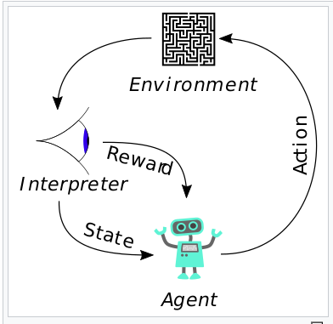
Reinforcement Learning
Reinforcement learning is learning what to do – how to map situations to actions – so as to maximize a numerical reward signal. The learner is not told which actions to take, but instead must discover which actions yield the most reward by trying them.

Slide 16
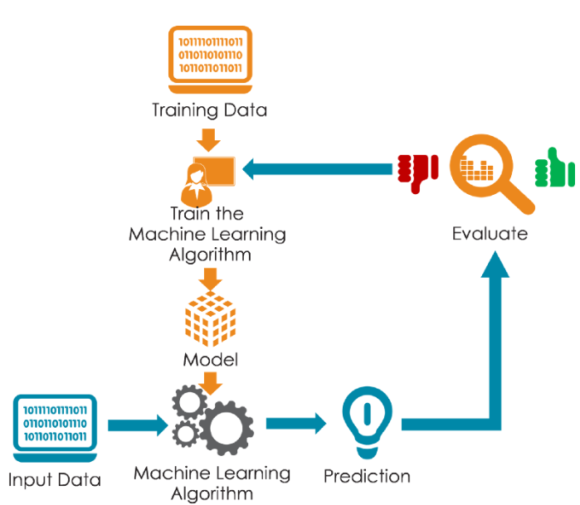
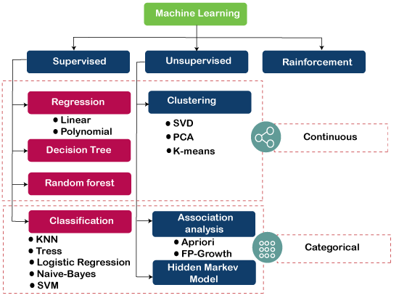


How to do Machine Learning? 7 steps of Machine Learning
Gathering data
Data preparation
Parameter tuning
Choosing a ML algorithm
Training the model
Evaluation
Validation Data
Predicting unseen data
Testing/Unseen Data
Notes:
So, how to do ML? The basic premise of machine learning is to build algorithms that can receive data and use statistical analysis to predict an output while updating outputs as new data becomes available.
There’re 7 steps to do in ML:
& 2. we need to gather and prepare the training data
3. Choose for a ML algorithm, there are different types of ML as we just introduced, and for each type of ML, there’re different ML algorithms
4. Fit the training data to the ML algorithm to train a model, i.e. using the algorithm to learn the set of rules form the training data
5. Fit validation data to the model and evaluate whether the prediction from the model is accurate or not
6. With the evaluation, we may need to adjust the parameters of the ML algorithm and train another model and evaluate again to come up with a good model to use
7. We can use the model to predict unseen data

Slide 17
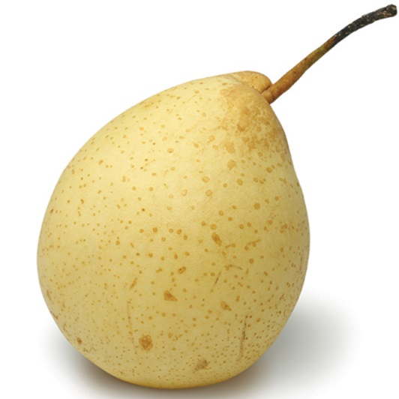
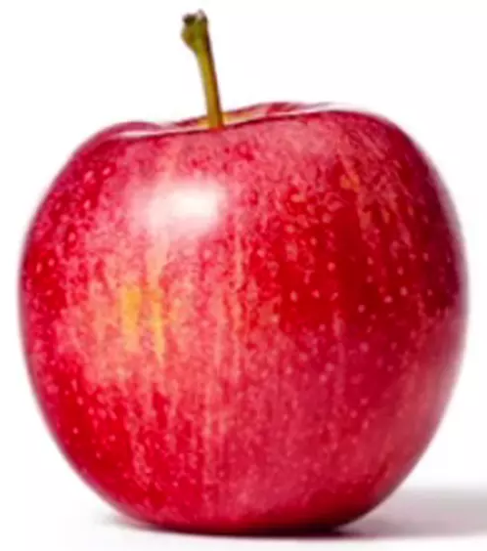
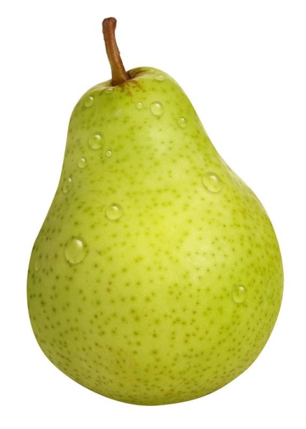
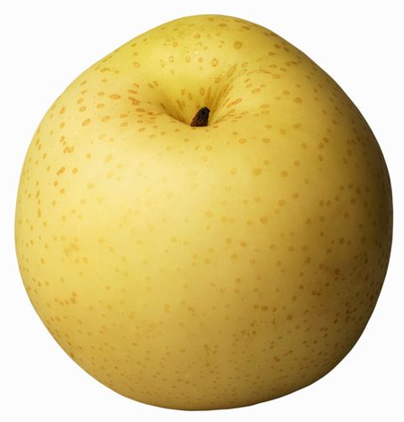
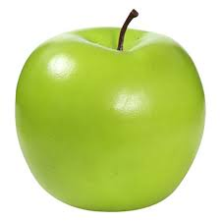
A Classification Example
Apple or Pear?
Color
Shape (width, height)
Weight
Sweetness
…
Notes:
Now, Let’s use a simple classification problem to understand what to do in the 7 steps of ML.
So, how to classify apple or pear?
Do we use color? Apples are red and pears are yellow?
But there’re also green apples and green pears, so we cannot use just color to do the classification
In addition, we may use shape: apples are round while pears are oval or triangle?
But there’re also round pears, so we may need other features as well, e.g. weight, sweetness, etc.

Slide 18


7 steps of Machine Learning (a classification example)
Step 1: Gathering Data
Quality and quantity of data that being gathered will directly determine how good the predictive model can be
Quality: balanced data
balanced number of apple and pear,
balanced number of different colors and different shapes
Quantity: too few samples may not be enough for training
Validation Data
Features
Testing/Unseen Data
Item | Color | Width | Height | Label
1 |  | 8.6 | 7.7 | Apple
2 |  | 5.3 | 4.8 | Apple
3 |  | 5.5 | 4.9 | Apple
: | : |  |  | :
: | : |  |  | :
999 |  | 5.5 | 7.8 | Pear
1000 |  | 5.4 | 8.2 | Pear
How much data is needed to train a Good Model?
Notes:
Step 1 is to gather data
Note that quality and quantity of the data may affect how good the model can be.
For quality, the data needs to be balanced, for this example, having balanced number of apples and pears, having balanced number of different colors and balanced number of different shapes.
Here, color and shape (or quantitatively we use width and height) are called features
Quantity of data is also important, too few samples may not be enough for training, producing a model which is not accurate.

Slide 19
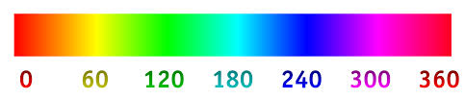
7 steps of Machine Learning (a classification example)
Step 2: Data preparation
Data cleaning
Transforming the data (Feature Engineering)
Randomize the order
Split the data:
~80% for training
~10% for validation
~10% for testing
Validation Data
Features
Testing/Unseen Data
Item | Color | Width | Height | Label
1 |  | 5.8 | 5.6 | Apple
2 |  | 5.5 | 7.8 | Pear
3 |  | 5.7 | 4.9 | Apple
4 |  | 6.8 | 5.9 | Pear
: | : | : |  | :
678 |  | ??? | ??? | Pear
: | : | : |  | :
1000 |  | 5.4 | 8.2 | Pear
16
62
85
58
Delete incomplete record
What ratio of data for training, validation and testing?
101
Notes:
After we gathered the data, 2nd we need to do data preparation, which includes
Data cleaning: e.g. deleting incomplete records
Transform the data, in ML we call this feature engineering: e.g. format the color to integers
Randomize the order: so that we won’t have the first 500 items being apples while the last 500 items being pears.
And then split the data, say 80% of data for training, 10% for validation and 10% for testing,
So why do we need to randomize the order? Suppose data is sorted in a specified order. E.g. 1st 500 items are apples while the 2nd 500 items are pears. Then, if you split data for training, validation, and testing without considering this subject, you will select 80% of data for training i.e. 500 apples + 300 pears for training which is unbalanced, and with validation and testing data all being pears, will fail the process. a simple solution is shuffling the data before splitting the data for training, validation, and testing.

Slide 20
7 steps of Machine Learning (a classification example)
Step 3: Choosing a ML algorithm
There are many different algorithms for different kinds of data or applications
some are very well suited for image data
some for sequences (like text, or music)
some for numerical data
some for text-based data
Validation Data
Testing/Unseen Data
Which algorithm to use?
Notes:
Step 3: Choosing a ML algorithm
There are many different algorithms for different kinds of data or applications:
some are very well suited for image data,
some for sequences (like text), etc.

Slide 21








7 steps of Machine Learning (a classification example)
Step 4: Training
Use the training data to incrementally improve the model’s ability to do prediction
i.e. to find the functions / the rules / patterns from the data
Validation Data
Testing/Unseen Data
Decision Tree Classifier
Starts with random weights
Adjust the weights → correct classification
Adjust the weights → correct classification
10
10
10
Color < 50
Color >= 50
Height
Height
Height
Height
< 5.4
>= 5.4
0
0
0
Notes:
Step 4 is training, which is to fit the training data to the ML algorithm to come up with a model and use the training data to incrementally improve the model’s ability to do prediction
i.e. to find the functions / rules for classification, or to find the patterns from the data
Each feature has a weight which is the importance of the feature in the classification
To simply the example, let’s consider only 2 features: color and height,
At the beginning, training starts with random weights of color and height resulting such a function to classify apple and pear, this also works for the 3rd item.
But the 4th item cannot be classified correctly, so the weights are adjusted, resulting this new function to classify this item correctly.
Again, the 5th item cannot be classified correctly, so the weights are adjusted, resulting this new function to classify this item correctly.
So, such process repeats for all the training data to come up with the weight of each feature i.e. a function like this or a set of rules (like this Decision Tree Classifier) which is called a model.

Slide 22
7 steps of Machine Learning (a classification example)
Step 5: Evaluation
After training is completed, use the validation data to evaluate if the model is good
This is to test the model against data that has never been used for training
Step 6: Parameter tuning
Step 7: Predicting unseen data
What parameters to tune and how to tune the parameters?
Validation Data
Testing/Unseen Data
Notes:
Step 5 is evaluation
After training is completed, use the validation data to evaluate if the model is good. E.g. We fit the validation data to the model to see if the prediction from the model matched with the label. This is to test the model against data that has never been used for training.
With the evaluation, we may need to adjust the parameters of the ML algorithm and train another model and evaluate again to come up with a good model to use.
Lastly, we can use the testing data to access the performance of the final model and use the model to do prediction.

Slide 23
Why we need to split the data into three sets?
Remember we split the whole dataset into three disjoint subsets training dataset, validation dataset and the testing dataset.
The major problem of training a model is overfitting, i.e., the model fits perfectly for the training data, but gives poor results for other data points.
In some applications, it is easy to build a model to fit perfectly the training data. For example, the Lagrange Interpolating polynomials tell us that for any set of points (x_i, y_i) on a 2-D plane, it is easy to create a polynomial that passes through all the points.

Slide 24
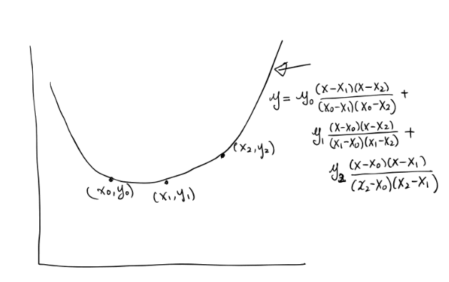
Why we need to split the data into three sets?
Example: any three points on a 2-D plane can be passed by a quadratic polynomial
Suppose in fact, the three points are lying on a straight line, with some noises pulling them a little away from the line.
By evaluating the model on a different dataset (i.e., the validation data set), we can discover immediately that the model is useless.
In such case, we repeat the process (with some change on the model building algorithm, e.g., tuning the parameters) to build a new model, which may not fit perfectly the training data, but fit much better for the validation data.

Slide 25
Why we need to split the data into three sets?
Repeat the training-validation cycles until we get a model that give “satisfactory” results for both the training dataset and validation dataset
This is our final model. But is it good? Is it possible that after so many training-validation cycles the model also overfit the validation data?
So, we evaluate the model by a totally different dataset (i.e., the testing dataset) and the result gives much more reliable measure of the accuracy of the model in general (remember we testing dataset are selected randomly and thus the general situation well).

Slide 26
Software libraries for ML

Slide 27
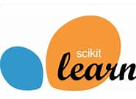
Traditional ML methods: scikit-learn
Scikit-learn (also known as sklearn) is a free software library for Python. It includes various traditional machine learning algorithms for classification, regression and clustering.
It was initially developed as a Google summer of code project in 2007. Later, the French institute INRIA got involved and the first public release was published in 2010.

Slide 28

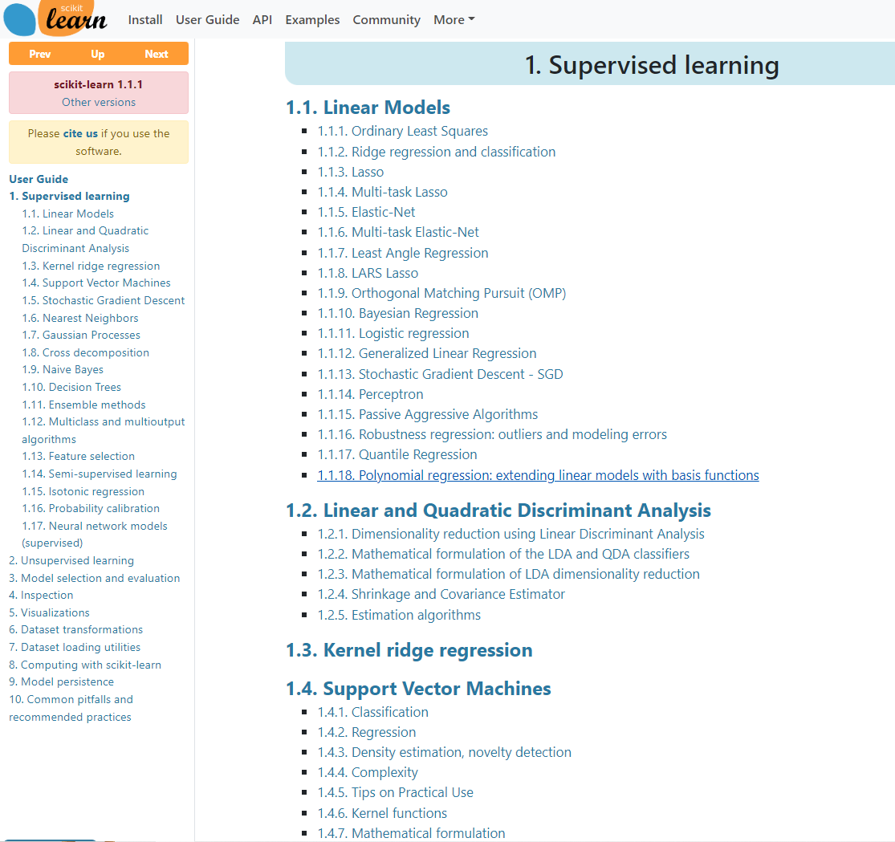
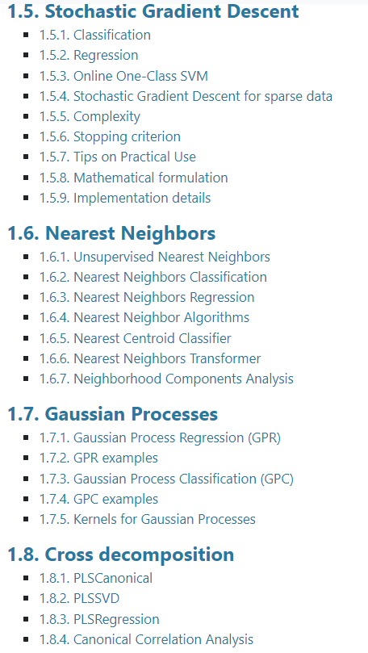
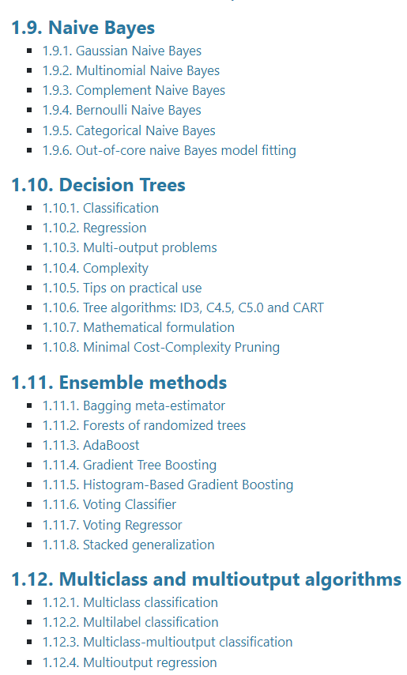
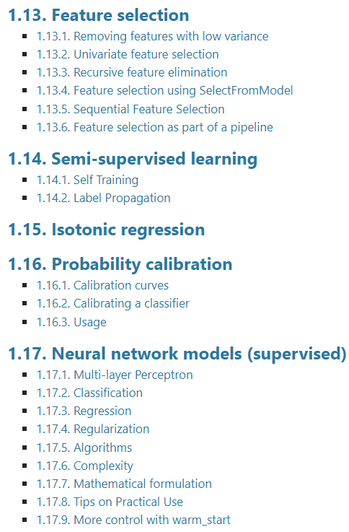

Slide 29
Some examples

Slide 30
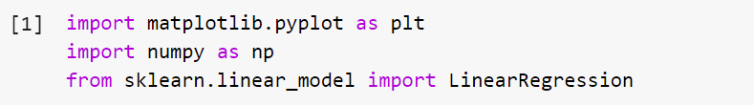

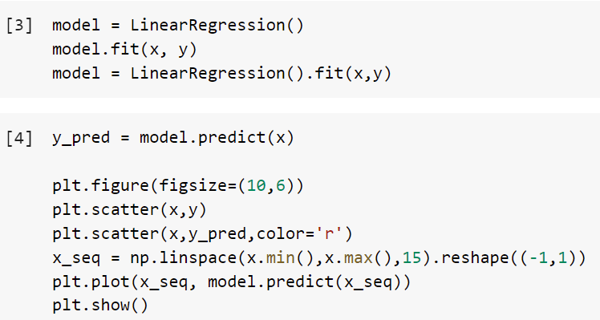
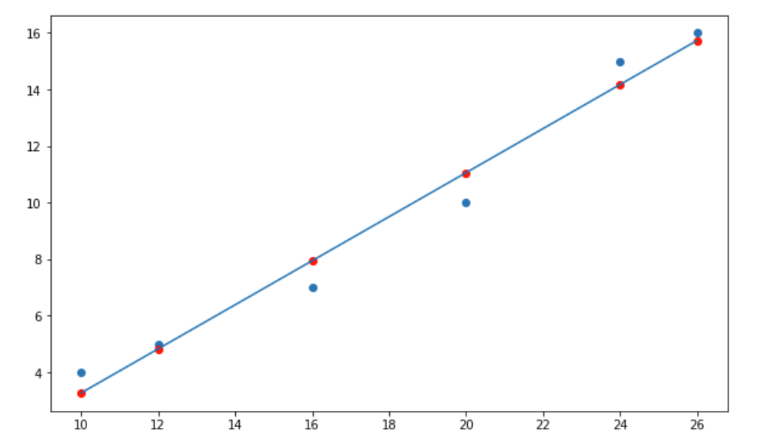
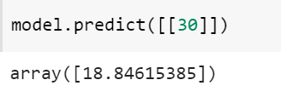
Supervised learning: Linear Regression model for predicting ice cream sales
Temperature (°C) x | Ice-cream Sales (No. of cones) y
10 | 4
12 | 5
16 | 7
20 | 10
24 | 15
30 | ?

Slide 31
Supervised learning: Linear Regression model for predicting ice cream sales
Temperature (°C) x | Ice-cream Sales (No. of cones) y
10 | 4
12 | 5
16 | 7
20 | 10
24 | 15
30 | ?
-1 ➔ the only possible
value here.
What’s it in this example?

Slide 32
Supervised learning: Linear Regression model for predicting ice cream sales
Temperature (°C) x | Ice-cream Sales (No. of cones) y
10 | 4
12 | 5
16 | 7
20 | 10
24 | 15
30 | ?
Why reshape() here?

Slide 33
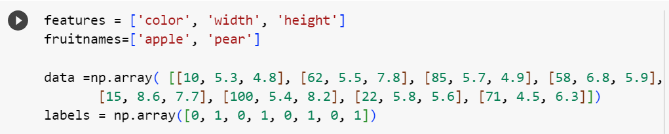
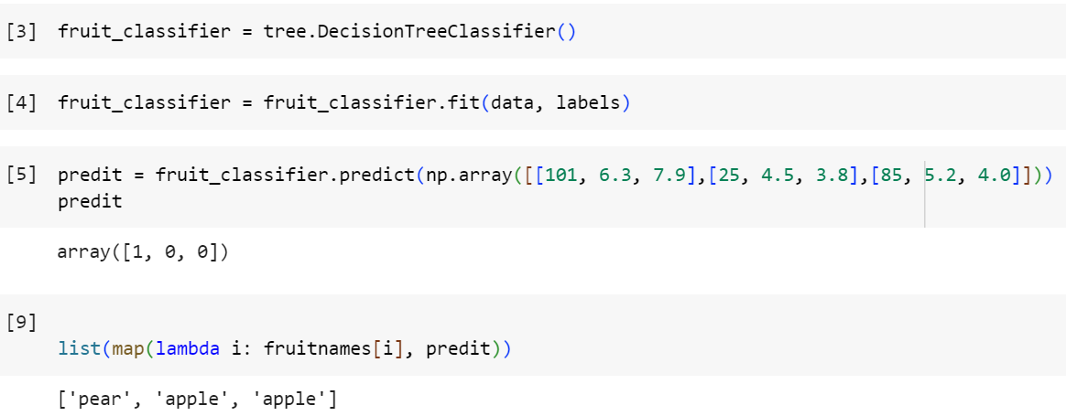
Supervised learning: Classifying Apple vs Pear

Slide 34
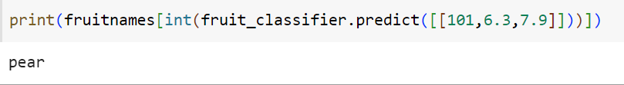
Supervised learning: Classifying Apple vs Pear

Slide 35
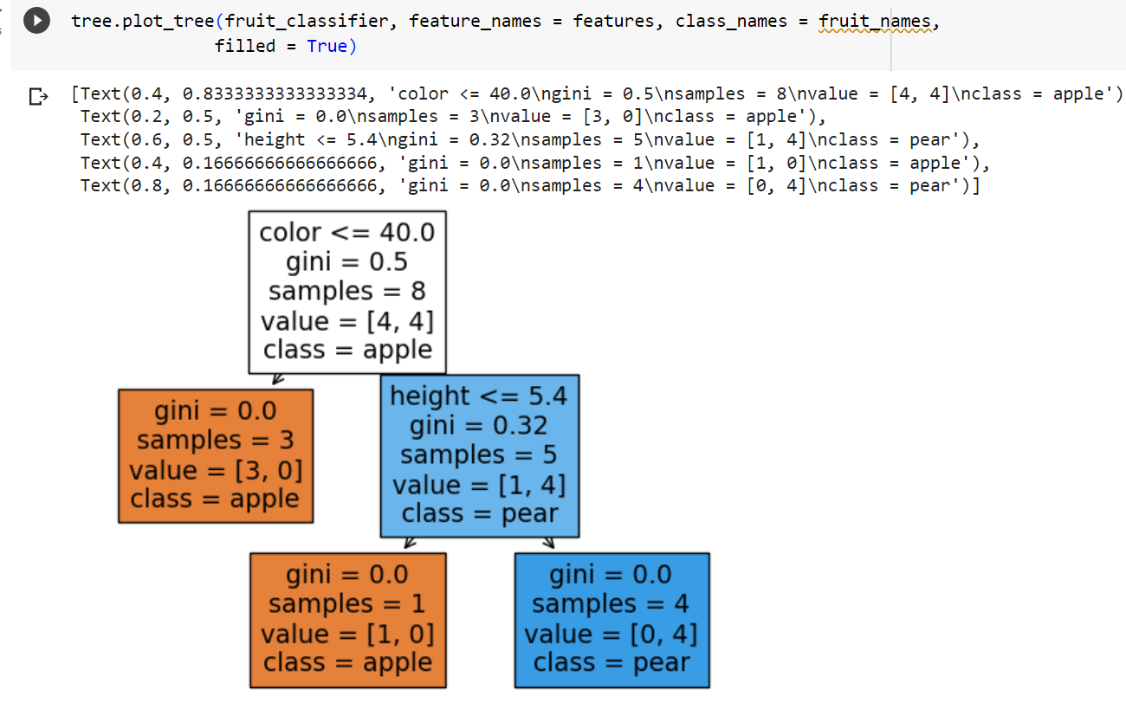
Supervised learning: Classifying Apple vs Pear

Slide 36
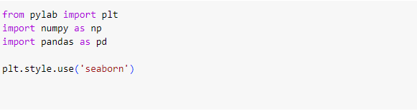
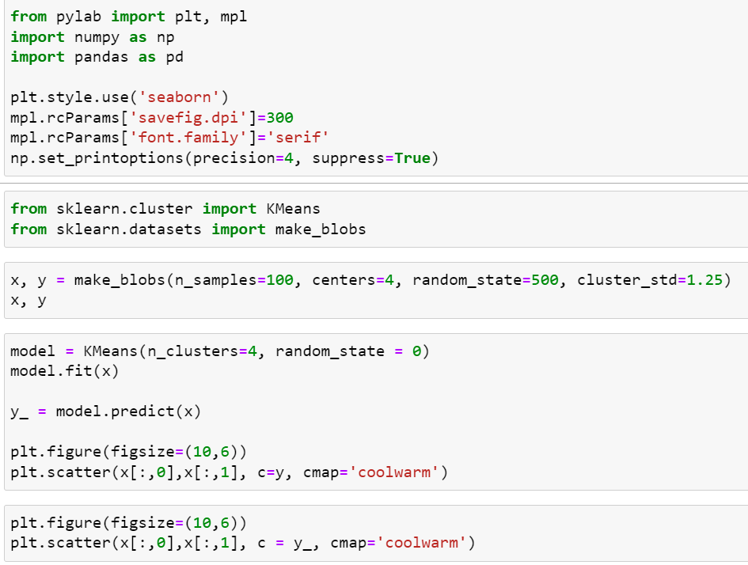
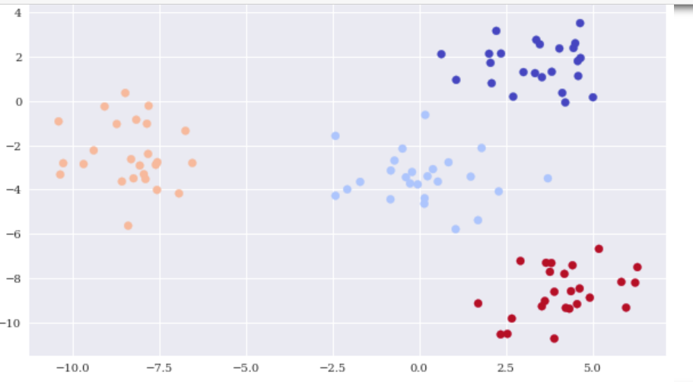
Unsupervised learning: clustering points on 2D plane

Slide 37
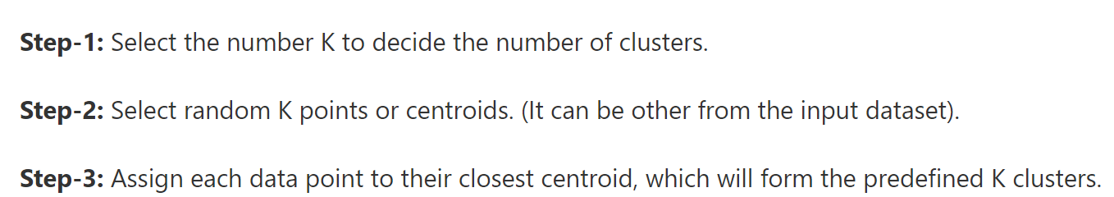
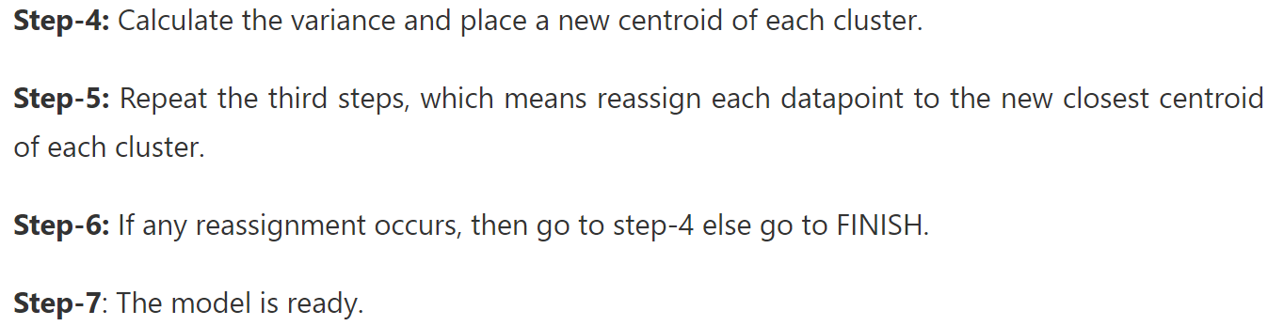
The K-means algorithm for clustering

Slide 38
Deep learning: TensorFlow and Keras
TensorFlow is a free software library for machine learning and AI. It can be used across a range of tasks but focuses on training and inference of deep neural networks.
TensorFlow was developed by the Google Brain team.
Keras is a free software library that provides a Python interface for neural network. It is commonly used as an interface for the TensorFlow library.

Slide 39
Deep learning: Tensorflow and Keras
Warning: The package tensorflow has many versions, and this causes some subtle problems when installing it using anaconda.
To avoid these subtle problems, you may run your programs on colab.

Slide 40
Example: classifying digits

Slide 41
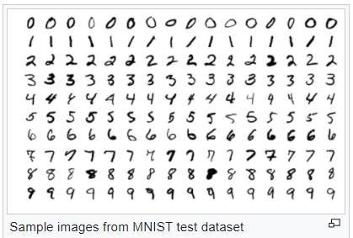
Deep Learning: Train a neural network for digit classification
The MNIST (Modified National Institute of Standards and Technology) dataset for training.
It is a large dataset of handwritten digits created in 1998.
Over the years, researchers used this dataset to test the accuracy of different ML methods.

Slide 42
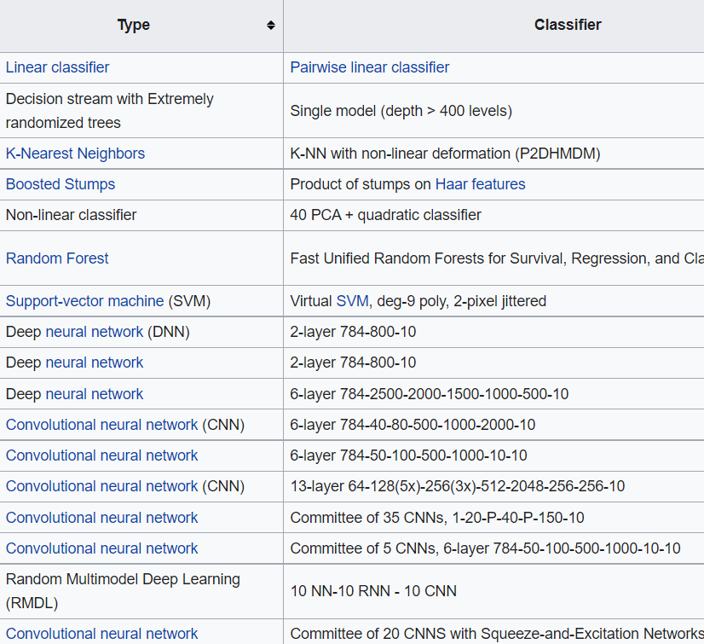
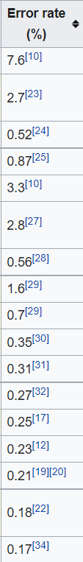

Slide 43
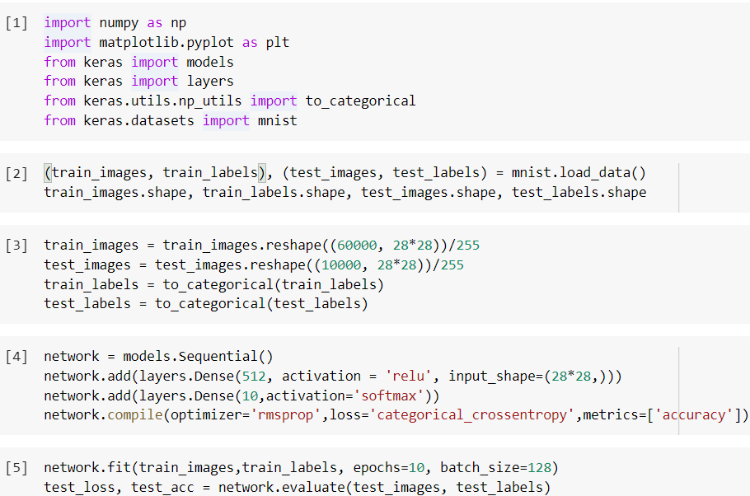
Deep Learning: Train a neural network for digit classification
I found that it does not
work with np_utils, and
removing it becomes okay.

Slide 44
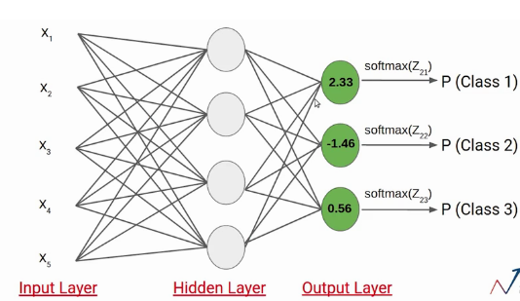
Deep Learning: Train a neural network for digit classification

Slide 45
Deep Learning: Train a neural network for digit classification

Slide 46
Deep Learning: Train a neural network for digit classification

Slide 47
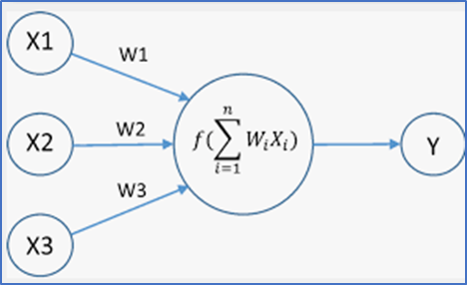
Deep Learning: Train a neural network for digit classification

Slide 48
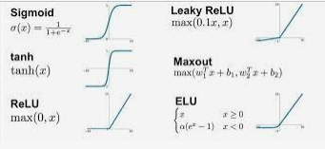
Deep Learning: Train a neural network for digit classification

Slide 49
Deep Learning: Train a neural network for digit classification

Slide 50
Deep Learning: Train a neural network for digit classification

Slide 51
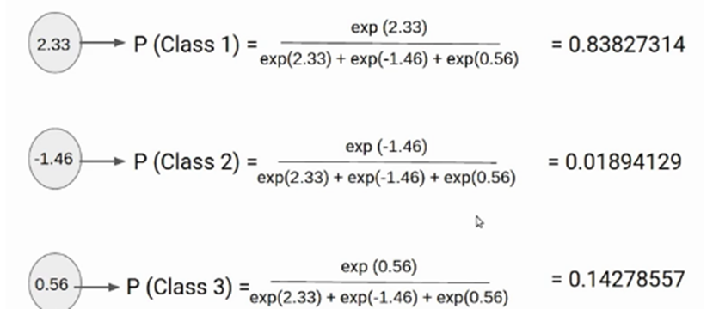
Deep Learning: Train a neural network for digit classification

Slide 52
Deep Learning: Train a neural network for digit classification
choose the largest one as
the ouput

Slide 53
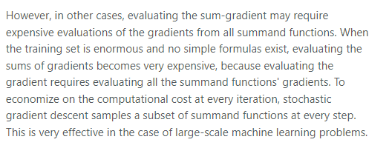
Deep Learning: Train a neural network for digit classification

Slide 54
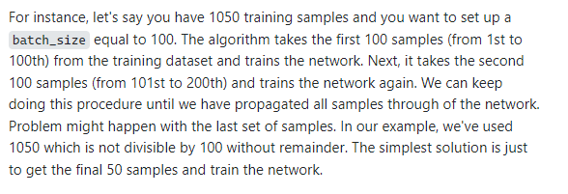
Deep Learning: Train a neural network for digit classification

Slide 55
Deep Learning: Train a neural network for digit classification
The number of complete passes
through the whole training data
set.

